Slide 1
Chapter 16: Recovery System

Slide 2
Chapter 16: Recovery System
Failure Classification
Storage Structure
Recovery and Atomicity
Log-Based Recovery
Remote Backup Systems

Slide 3
Failure Classification
Transaction failure :
Logical errors: transaction cannot complete due to some internal error condition
System errors: the database system must terminate an active transaction due to an error condition (e.g., deadlock)
System crash: a power failure or other hardware or software failure causes the system to crash.
Fail-stop assumption: non-volatile storage contents are assumed to not be corrupted by system crash
Database systems have numerous integrity checks to prevent corruption of disk data
Disk failure: a head crash or similar disk failure destroys all or part of disk storage
Destruction is assumed to be detectable: disk drives use checksums to detect failures

Slide 4
Recovery Algorithms
Consider transaction T_{i} that transfers $50 from account A to account B
Two updates: subtract 50 from A and add 50 to B
Transaction T_{i} requires updates to A and B to be output to the database.
A failure may occur after one of these modifications have been made but before both of them are made.
Modifying the database without ensuring that the transaction will commit may leave the database in an inconsistent state
Not modifying the database may result in lost updates if failure occurs just after transaction commits
Recovery algorithms have two parts
Actions taken during normal transaction processing to ensure enough information exists to recover from failures
Actions taken after a failure to recover the database contents to a state that ensures atomicity, consistency and durability

Slide 5
Storage Structure
Volatile storage:
does not survive system crashes
examples: main memory, cache memory
Nonvolatile storage:
survives system crashes
examples: disk, tape, flash memory, non-volatile (battery backed up) RAM
but may still fail, losing data
Stable storage:
a mythical form of storage that survives all failures
approximated by maintaining multiple copies on distinct nonvolatile media

Slide 6
Stable-Storage Implementation
Maintain multiple copies of each block on separate disks
copies can be at remote sites to protect against disasters such as fire or flooding.
Failure during data transfer can still result in inconsistent copies: Block transfer can result in
Successful completion
Partial failure: destination block has incorrect information
Total failure: destination block was never updated
Protecting storage media from failure during data transfer (one solution):
Execute output operation as follows (assuming two copies of each block):
Write the information onto the first physical block.
When the first write successfully completes, write the same information onto the second physical block.
The output is completed only after the second write successfully completes.
Notes:
6

Slide 7
Stable-Storage Implementation (Cont.)
Protecting storage media from failure during data transfer (cont.):
Copies of a block may differ due to failure during output operation. To recover from failure:
First find inconsistent blocks:
Expensive solution: Compare the two copies of every disk block.
Better solution:
Record in-progress disk writes on non-volatile storage (Non-volatile RAM or special area of disk).
Use this information during recovery to find blocks that may be inconsistent, and only compare copies of these.
Used in hardware RAID systems
If either copy of an inconsistent block is detected to have an error (bad checksum), overwrite it by the other copy. If both have no error, but are different, overwrite the second block by the first block.
Notes:
7

Slide 8
Data Access
Physical blocks are those blocks residing on the disk.
Buffer blocks are the blocks residing temporarily in main memory.
Block movements between disk and main memory are initiated through the following two operations:
input(B) transfers the physical block B to main memory.
output(B) transfers the buffer block B to the disk, and replaces the appropriate physical block there.
We assume, for simplicity, that each data item fits in, and is stored inside, a single block.

Slide 9
Example of Data Access
buffer
Buffer Block A
input(A)
X
A
Buffer Block B
Y
B
output(B)
read(X)
write(Y)
x₂
x₁
y₁
work area
of T₁
work area
of T₂
memory
disk

Slide 10
Data Access (Cont.)
Each transaction T_{i} has its private work-area in which local copies of all data items accessed and updated by it are kept.
T_{i}'s local copy of a data item X is called x_{i}.
Transferring data items between system buffer blocks and its private work-area done by:
read(X) assigns the value of data item X to the local variable x_{i}.
write(X) assigns the value of local variable x_{i} to data item {X} in the buffer block.
Note: output(B_{X}) need not immediately follow write(X). System can perform the output operation when it deems fit.
Transactions
Must perform read(X) before accessing X for the first time (subsequent reads can be from local copy)
write(X) can be executed at any time before the transaction commits

Slide 11
Recovery and Atomicity
To ensure atomicity despite failures, we first output information describing the modifications to stable storage without modifying the database itself.
We study log-based recovery mechanisms in detail
We first present key concepts
And then present the actual recovery algorithm
Less used alternative: shadow-paging (brief details in book)

Slide 12
Log-Based Recovery
A log is kept on stable storage.
The log is a sequence of log records, and maintains a record of update activities on the database.
When transaction T_{i} starts, it registers itself by writing a <T_{i} start>log record
Before T_{i} executes write(X), a log record <T_{i}, X, V₁, V₂> is written, where V₁ is the value of X before the write (the old value), and V₂ is the value to be written to X (the new value).
When T_{i} finishes it last statement, the log record <T_{i} commit> is written.
Two approaches using logs
Deferred database modification
Immediate database modification

Slide 13
Immediate Database Modification
The immediate-modification scheme allows updates of an uncommitted transaction to be made to the buffer, or the disk itself, before the transaction commits
Update log record must be written before database item is written
We assume that the log record is output directly to stable storage
(Will see later that how to postpone log record output to some extent)
Output of updated blocks to stable storage can take place at any time before or after transaction commit
Order in which blocks are output can be different from the order in which they are written.
The deferred-modification scheme performs updates to buffer/disk only at the time of transaction commit
Simplifies some aspects of recovery
But has overhead of storing local copy

Slide 14
Transaction Commit
A transaction is said to have committed when its commit log record is output to stable storage
all previous log records of the transaction must have been output already
Writes performed by a transaction may still be in the buffer when the transaction commits, and may be output later

Slide 15
Immediate Database Modification Example
B_{C} output before T₁ commits
B_{A} output after T₀ commits
Log Write Output
<T₀ start>
<T₀, A, 1000, 950>
<T_{o}, B, 2000, 2050
A = 950
B = 2050
<T₀ commit>
<T₁ start>
<T₁, C, 700, 600>
C = 600
B_{B} , B_{C}
<T₁ commit>
B_{A}
Note: B_{X} denotes block containing X.

Slide 16
Concurrency Control and Recovery
With concurrent transactions, all transactions share a single disk buffer and a single log
A buffer block can have data items updated by one or more transactions
We assume that if a transaction T_{i} has modified an item, no other transaction can modify the same item until T_{i} has committed or aborted
i.e. the updates of uncommitted transactions should not be visible to other transactions
Otherwise how to perform undo if T1 updates A, then T2 updates A and commits, and finally T1 has to abort?
Can be ensured by obtaining exclusive locks on updated items and holding the locks till end of transaction (strict two-phase locking)
Log records of different transactions may be interspersed in the log.

Slide 17
Undo and Redo Operations
Undo of a log record <T_{i}, X, V₁, V₂> writes the old value V₁ to X
Redo of a log record <T_{i}, X, V₁, V₂> writes the new value V₂ to X
Undo and Redo of Transactions
undo(T_{i}) restores the value of all data items updated by T_{i} to their old values, going backwards from the last log record for T_{i}
each time a data item X is restored to its old value V a special log record <T_{i} , X, V> is written out
when undo of a transaction is complete, a log record <T_{i} abort> is written out.
redo(T_{i}) sets the value of all data items updated by T_{i} to the new values, going forward from the first log record for T_{i}
No logging is done in this case

Slide 18
Undo and Redo on Recovering from Failure
When recovering after failure:
Transaction T_{i} needs to be undone if the log
contains the record <T_{i} start>,
but does not contain either the record <T_{i} commit> or <T_{i} abort>.
Transaction T_{i} needs to be redone if the log
contains the records <T_{i} start>
and contains the record <T_{i} commit> or <T_{i} abort>
Note that If transaction T_{i} was undone earlier and the <T_{i} abort> record written to the log, and then a failure occurs, on recovery from failure T_{i} is redone
such a redo redoes all the original actions including the steps that restored old values
Known as repeating history
Seems wasteful, but simplifies recovery greatly

Slide 19
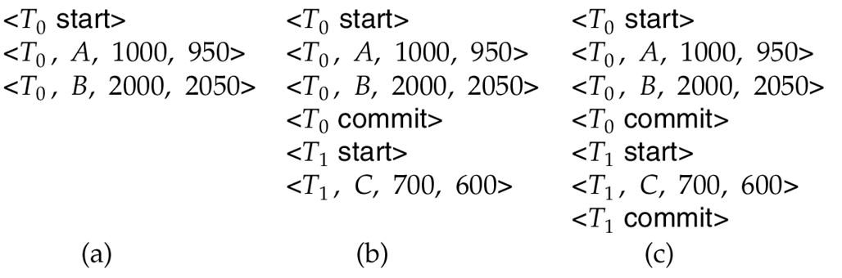
Immediate DB Modification Recovery Example
Below we show the log as it appears at three instances of time.
Recovery actions in each case above are:
(a) undo (T₀): B is restored to 2000 and A to 1000, and log records <T₀, B, 2000>, <T₀, A, 1000>, <T₀, abort> are written out
(b) redo (T₀) and undo (T₁): A and B are set to 950 and 2050 and C is restored to 700. Log records <T₁, C, 700>, <T₁, abort> are written out.
(c) redo (T₀) and redo (T₁): A and B are set to 950 and 2050
respectively. Then C is set to 600

Slide 20
Checkpoints
Redoing/undoing all transactions recorded in the log can be very slow
processing the entire log is time-consuming if the system has run for a long time
we might unnecessarily redo transactions which have already output their updates to the database.
Streamline recovery procedure by periodically performing checkpointing
Output all log records currently residing in main memory onto stable storage.
Output all modified buffer blocks to the disk.
Write a log record < checkpoint L> onto stable storage where L is a list of all transactions active at the time of checkpoint.
All updates are stopped while doing checkpointing

Slide 21
Checkpoints (Cont.)
During recovery we need to consider only the most recent transaction T_{i} that started before the checkpoint, and transactions that started after T_{i}.
Scan backwards from end of log to find the most recent <checkpoint L> record
Only transactions that are in L or started after the checkpoint need to be redone or undone
Transactions that committed or aborted before the checkpoint already have all their updates output to stable storage.
Some earlier part of the log may be needed for undo operations
Continue scanning backwards till a record <T_{i} start> is found for every transaction T_{i} in L.
Parts of log prior to earliest <T_{i} start> record above are not needed for recovery, and can be erased whenever desired.

Slide 22
Example of Checkpoints
T_{c}
T_{f}
T₁ can be ignored (updates already output to disk due to checkpoint)
T₂ and T₃ redone.
T₄ undone
T₁
T₂
T₃
T₄
checkpoint
system failure

Slide 23
Recovery Algorithm
So far: we covered key concepts
Now: we present the components of the basic recovery algorithm
Later: we present extensions to allow more concurrency

Slide 24
Recovery Algorithm
Logging (during normal operation):
<T_{i} start> at transaction start
<T_{i}, X_{j}, V₁, V₂> for each update, and
<T_{i} commit> at transaction end
Transaction rollback (during normal operation)
Let T_{i} be the transaction to be rolled back
Scan log backwards from the end, and for each log record of T_{i} of the form <T_{i}, X_{j}, V₁, V₂>
perform the undo by writing V₁ to X_{j},
write a log record <T_{i} , X_{j}, V₁>
such log records are called compensation log records
Once the record <T_{i} start> is found stop the scan and write the log record <T_{i} abort>

Slide 25
Recovery Algorithm (Cont.)
Recovery from failure: Two phases
Redo phase: replay updates of all transactions, whether they committed, aborted, or are incomplete
Undo phase: undo all incomplete transactions
Redo phase:
Find last <checkpoint L> record, and set undo-list to L.
Scan forward from above <checkpoint L> record
Whenever a record <T_{i}, X_{j}, V₁, V₂> is found, redo it by writing V₂ to X_{j}
Whenever a log record <T_{i} start> is found, add T_{i} to undo-list
Whenever a log record <T_{i} commit> or <T_{i} abort> is found, remove T_{i} from undo-list

Slide 26
Recovery Algorithm (Cont.)
Undo phase:
Scan log backwards from end
Whenever a log record <T_{i}, X_{j}, V₁, V₂> is found where T_{i} is in undo-list perform same actions as for transaction rollback:
perform undo by writing V₁ to X_{j}.
write a log record <T_{i} , X_{j}, V₁>
Whenever a log record <T_{i} start> is found where T_{i} is in undo-list,
Write a log record <T_{i} abort>
Remove T_{i} from undo-list
Stop when undo-list is empty
i.e. <T_{i} start> has been found for every transaction in undo-list
After undo phase completes, normal transaction processing can commence

Slide 27
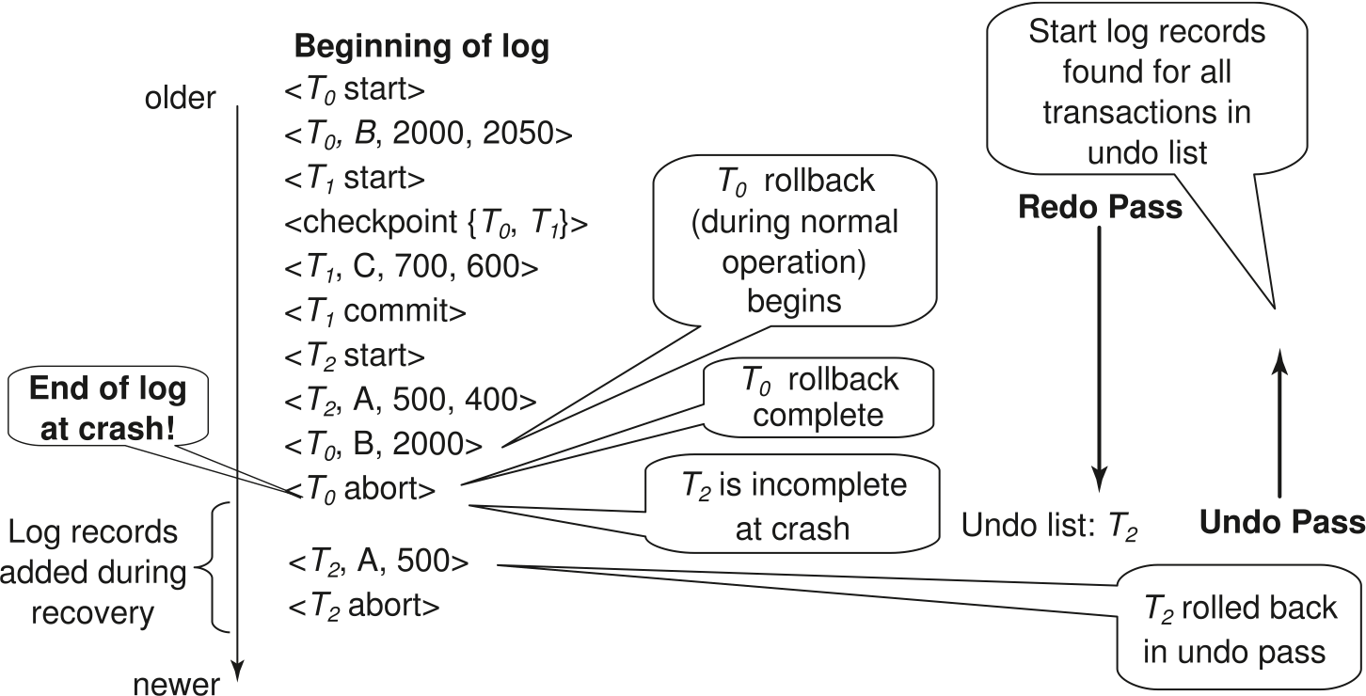
Example of Recovery

Slide 28
Log Record Buffering
Log record buffering: log records are buffered in main memory, instead of of being output directly to stable storage.
Log records are output to stable storage when a block of log records in the buffer is full, or a log force operation is executed.
Log force is performed to commit a transaction by forcing all its log records (including the commit record) to stable storage.
Several log records can thus be output using a single output operation, reducing the I/O cost.

Slide 29
Log Record Buffering (Cont.)
The rules below must be followed if log records are buffered:
Log records are output to stable storage in the order in which they are created.
Transaction T_{i} enters the commit state only when the log record <T_{i} commit> has been output to stable storage.
Before a block of data in main memory is output to the database, all log records pertaining to data in that block must have been output to stable storage.
This rule is called the write-ahead logging or WAL rule
Strictly speaking WAL only requires undo information to be output

Slide 30
Database Buffering
Database maintains an in-memory buffer of data blocks
When a new block is needed, if buffer is full an existing block needs to be removed from buffer
If the block chosen for removal has been updated, it must be output to disk
The recovery algorithm supports the no-force policy: i.e., updated blocks need not be written to disk when transaction commits
force policy: requires updated blocks to be written at commit
More expensive commit
The recovery algorithm supports the steal policy:i.e., blocks containing updates of uncommitted transactions can be written to disk, even before the transaction commits

Slide 31
Database Buffering (Cont.)
If a block with uncommitted updates is output to disk, log records with undo information for the updates are output to the log on stable storage first
(Write ahead logging)
No updates should be in progress on a block when it is output to disk. Can be ensured as follows.
Before writing a data item, transaction acquires exclusive lock on block containing the data item
Lock can be released once the write is completed.
Such locks held for short duration are called latches.
To output a block to disk
First acquire an exclusive latch on the block
Ensures no update can be in progress on the block
Then perform a log flush
Then output the block to disk
Finally release the latch on the block
Notes:
31

Slide 32
Buffer Management (Cont.)
Database buffer can be implemented either
in an area of real main-memory reserved for the database, or
in virtual memory
Implementing buffer in reserved main-memory has drawbacks:
Memory is partitioned before-hand between database buffer and applications, limiting flexibility.
Needs may change, and although operating system knows best how memory should be divided up at any time, it cannot change the partitioning of memory.

Slide 33
Buffer Management (Cont.)
Database buffers are generally implemented in virtual memory in spite of some drawbacks:
When operating system needs to evict a page that has been modified, the page is written to swap space on disk.
When database decides to write buffer page to disk, buffer page may be in swap space, and may have to be read from swap space on disk and output to the database on disk, resulting in extra I/O!
Known as dual paging problem.
Ideally when OS needs to evict a page from the buffer, it should pass control to database, which in turn should
Output the page to database instead of to swap space (making sure to output log records first), if it is modified
Release the page from the buffer, for the OS to use
Dual paging can thus be avoided, but common operating systems do not support such functionality.

Slide 34
Fuzzy Checkpointing
To avoid long interruption of normal processing during checkpointing, allow updates to happen during checkpointing
Fuzzy checkpointing is done as follows:
Temporarily stop all updates by transactions
Write a <checkpoint L> log record and force log to stable storage
Note list M of modified buffer blocks
Now permit transactions to proceed with their actions
Output to disk all modified buffer blocks in list M
blocks should not be updated while being output
Follow WAL: all log records pertaining to a block must be output before the block is output
Store a pointer to the checkpoint record in a fixed position last_checkpoint on disk
Notes:
34

Slide 35
Fuzzy Checkpointing (Cont.)
When recovering using a fuzzy checkpoint, start scan from the checkpoint record pointed to by last_checkpoint
Log records before last_checkpoint have their updates reflected in database on disk, and need not be redone.
Incomplete checkpoints, where system had crashed while performing checkpoint, are handled safely
……
<checkpoint L>
…..
<checkpoint L>
…..
last_checkpoint
Log
Notes:
35

Slide 36
Failure with Loss of Nonvolatile Storage
So far we assumed no loss of non-volatile storage
Technique similar to checkpointing used to deal with loss of non-volatile storage
Periodically dump the entire content of the database to stable storage
No transaction may be active during the dump procedure; a procedure similar to checkpointing must take place
Output all log records currently residing in main memory onto stable storage.
Output all buffer blocks onto the disk.
Copy the contents of the database to stable storage.
Output a record <dump> to log on stable storage.

Slide 37
Recovering from Failure of Non-Volatile Storage
To recover from disk failure
restore database from most recent dump.
Consult the log and redo all transactions that committed after the dump
Can be extended to allow transactions to be active during dump; known as fuzzy dump or online dump
Similar to fuzzy checkpointing

Slide 38
Recovery with Early Lock Release and Logical Undo Operations

Slide 39
Recovery with Early Lock Release
Support for high-concurrency locking techniques, such as those used for B⁺-tree concurrency control, which release locks early
Supports “logical undo”
Recovery based on “repeating history”, whereby recovery executes exactly the same actions as normal processing

Slide 40
Logical Undo Logging
Operations like B⁺-tree insertions and deletions release locks early.
They cannot be undone by restoring old values (physical undo), since once a lock is released, other transactions may have updated the B⁺-tree.
Instead, insertions (resp. deletions) are undone by executing a deletion (resp. insertion) operation (known as logical undo).
For such operations, undo log records should contain the undo operation to be executed
Such logging is called logical undo logging, in contrast to physical undo logging
Operations are called logical operations
Other examples:
delete of tuple, to undo insert of tuple
allows early lock release on space allocation information
subtract amount deposited, to undo deposit
allows early lock release on bank balance

Slide 41
Physical Redo
Redo information is logged physically (that is, new value for each write) even for operations with logical undo
Logical redo is very complicated since database state on disk may not be “operation consistent” when recovery starts
Physical redo logging does not conflict with early lock release

Slide 42
Operation Logging
Operation logging is done as follows:
When operation starts, log <T_{i}, O_{j}, operation-begin>. Here O_{j} is a unique identifier of the operation instance.
While operation is executing, normal log records with physical redo and physical undo information are logged.
When operation completes, <T_{i}, O_{j}, operation-end, U> is logged, where U contains information needed to perform a logical undo information.
Example: insert of (key, record-id) pair (K5, RID7) into index I9
<T1, O1, operation-begin>
….
<T1, X, 10, K5>
<T1, Y, 45, RID7>
<T1, O1, operation-end, (delete I9, K5, RID7)>
Physical redo of steps in insert

Slide 43
Operation Logging (Cont.)
If crash/rollback occurs before operation completes:
the operation-end log record is not found, and
the physical undo information is used to undo operation.
If crash/rollback occurs after the operation completes:
the operation-end log record is found, and in this case
logical undo is performed using U; the physical undo information for the operation is ignored.
Redo of operation (after crash) still uses physical redo information.

Slide 44
Transaction Rollback with Logical Undo
Rollback of transaction T_{i} is done as follows:
Scan the log backwards
If a log record <T_{i}, X, V₁, V₂> is found, perform the undo and log a al <T_{i}, X, V₁>.
If a <T_{i}, O_{j}, operation-end, U> record is found
Rollback the operation logically using the undo information U.
Updates performed during roll back are logged just like during normal operation execution.
At the end of the operation rollback, instead of logging an operation-end record, generate a record
<T_{i}, O_{j}, operation-abort>.
Skip all preceding log records for T_{i} until the record <T_{i}, O_{j} operation-begin> is found

Slide 45
Transaction Rollback with Logical Undo (Cont.)
Transaction rollback, scanning the log backwards (cont.):
If a redo-only record is found ignore it
If a <T_{i}, O_{j}, operation-abort> record is found:
skip all preceding log records for T_{i} until the record <T_{i}, O_{j}, operation-begin> is found.
Stop the scan when the record <T_{i}, start> is found
Add a <T_{i}, abort> record to the log
Some points to note:
Cases 3 and 4 above can occur only if the database crashes while a transaction is being rolled back.
Skipping of log records as in case 4 is important to prevent multiple rollback of the same operation.

Slide 46
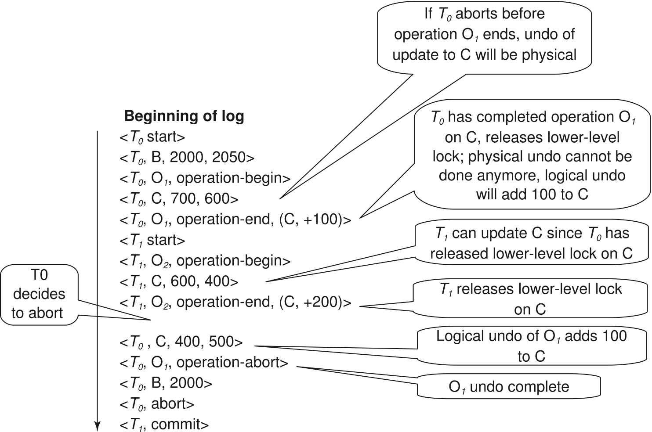
Transaction Rollback with Logical Undo
Transaction rollback during normal operation

Slide 47
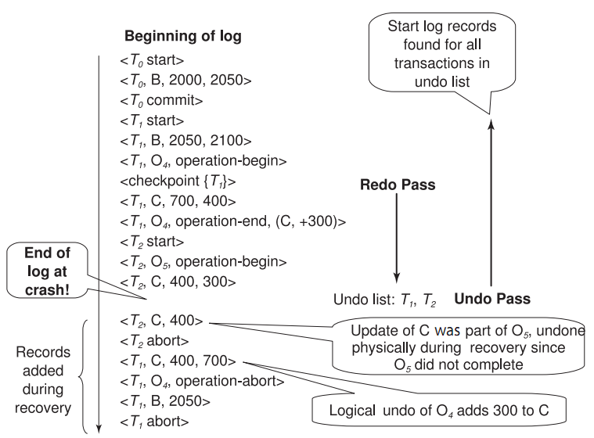
Failure Recovery with Logical Undo

Slide 48
Transaction Rollback: Another Example
Example with a complete and an incomplete operation
<T1, start>
<T1, O1, operation-begin>
….
<T1, X, 10, K5>
<T1, Y, 45, RID7>
<T1, O1, operation-end, (delete I9, K5, RID7)>
<T1, O2, operation-begin>
<T1, Z, 45, 70> ← T1 Rollback begins here
<T1, Z, 45> ← redo-only log record during physical undo (of incomplete O2)
<T1, Y, .., ..> ← Normal redo records for logical undo of O1
…
<T1, O1, operation-abort> ← What if crash occurred immediately after this?
<T1, abort>

Slide 49
Recovery Algorithm with Logical Undo
Basically same as earlier algorithm, except for changes described earlier for transaction rollback
(Redo phase): Scan log forward from last < checkpoint L> record till end of log
Repeat history by physically redoing all updates of all transactions,
Create an undo-list during the scan as follows
undo-list is set to L initially
Whenever <T_{i} start> is found T_{i} is added to undo-list
Whenever <T_{i} commit> or <T_{i} abort> is found, T_{i} is deleted from undo-list
This brings database to state as of crash, with committed as well as uncommitted transactions having been redone.
Now undo-list contains transactions that are incomplete, that is, have neither committed nor been fully rolled back.

Slide 50
Recovery with Logical Undo (Cont.)
Recovery from system crash (cont.)
(Undo phase): Scan log backwards, performing undo on log records of transactions found in undo-list.
Log records of transactions being rolled back are processed as described earlier, as they are found
Single shared scan for all transactions being undone
When <T_{i} start> is found for a transaction T_{i} in undo-list, write a <T_{i} abort> log record.
Stop scan when <T_{i} start> records have been found for all T_{i} in undo-list
This undoes the effects of incomplete transactions (those with neither commit nor abort log records). Recovery is now complete.

Slide 51
ARIES Recovery Algorithm

Slide 52
ARIES
ARIES is a state of the art recovery method
Incorporates numerous optimizations to reduce overheads during normal processing and to speed up recovery
The recovery algorithm we studied earlier is modeled after ARIES, but greatly simplified by removing optimizations
Unlike the recovery algorithm described earlier, ARIES
Uses log sequence number (LSN) to identify log records
Stores LSNs in pages to identify what updates have already been applied to a database page
Physiological redo
Dirty page table to avoid unnecessary redos during recovery
Fuzzy checkpointing that only records information about dirty pages, and does not require dirty pages to be written out at checkpoint time
More coming up on each of the above …

Slide 53
ARIES Optimizations
Physiological redo
Affected page is physically identified, action within page can be logical
Used to reduce logging overheads
e.g. when a record is deleted and all other records have to be moved to fill hole
Physiological redo can log just the record deletion
Physical redo would require logging of old and new values for much of the page
Requires page to be output to disk atomically
Easy to achieve with hardware RAID, also supported by some disk systems
Incomplete page output can be detected by checksum techniques,
But extra actions are required for recovery
Treated as a media failure

Slide 54
ARIES Data Structures
ARIES uses several data structures
Log sequence number (LSN) identifies each log record
Must be sequentially increasing
Typically an offset from beginning of log file to allow fast access
Easily extended to handle multiple log files
Page LSN
Log records of several different types
Dirty page table

Slide 55
ARIES Data Structures: Page LSN
Each page contains a PageLSN which is the LSN of the last log record whose effects are reflected on the page
To update a page:
X-latch the page, and write the log record
Update the page
Record the LSN of the log record in PageLSN
Unlock page
To flush page to disk, must first S-latch page
Thus page state on disk is operation consistent
Required to support physiological redo
PageLSN is used during recovery to prevent repeated redo
Thus ensuring idempotence

Slide 56
ARIES Data Structures: Log Record
Each log record contains LSN of previous log record of the same transaction
LSN in log record may be implicit
Special redo-only log record called compensation log record (CLR) used to log actions taken during recovery that never need to be undone
Serves the role of operation-abort log records used in earlier recovery algorithm
Has a field UndoNextLSN to note next (earlier) record to be undone
Records in between would have already been undone
Required to avoid repeated undo of already undone actions
LSN TransID PrevLSN RedoInfo UndoInfo
LSN TransID UndoNextLSN RedoInfo
1
2
3
4
4'
3'
2'
1'

Slide 57
ARIES Data Structures: DirtyPage Table
DirtyPageTable
List of pages in the buffer that have been updated
Contains, for each such page
PageLSN of the page
RecLSN is an LSN such that log records before this LSN have already been applied to the page version on disk
Set to current end of log when a page is inserted into dirty page table (just before being updated)
Recorded in checkpoints, helps to minimize redo work

Slide 58
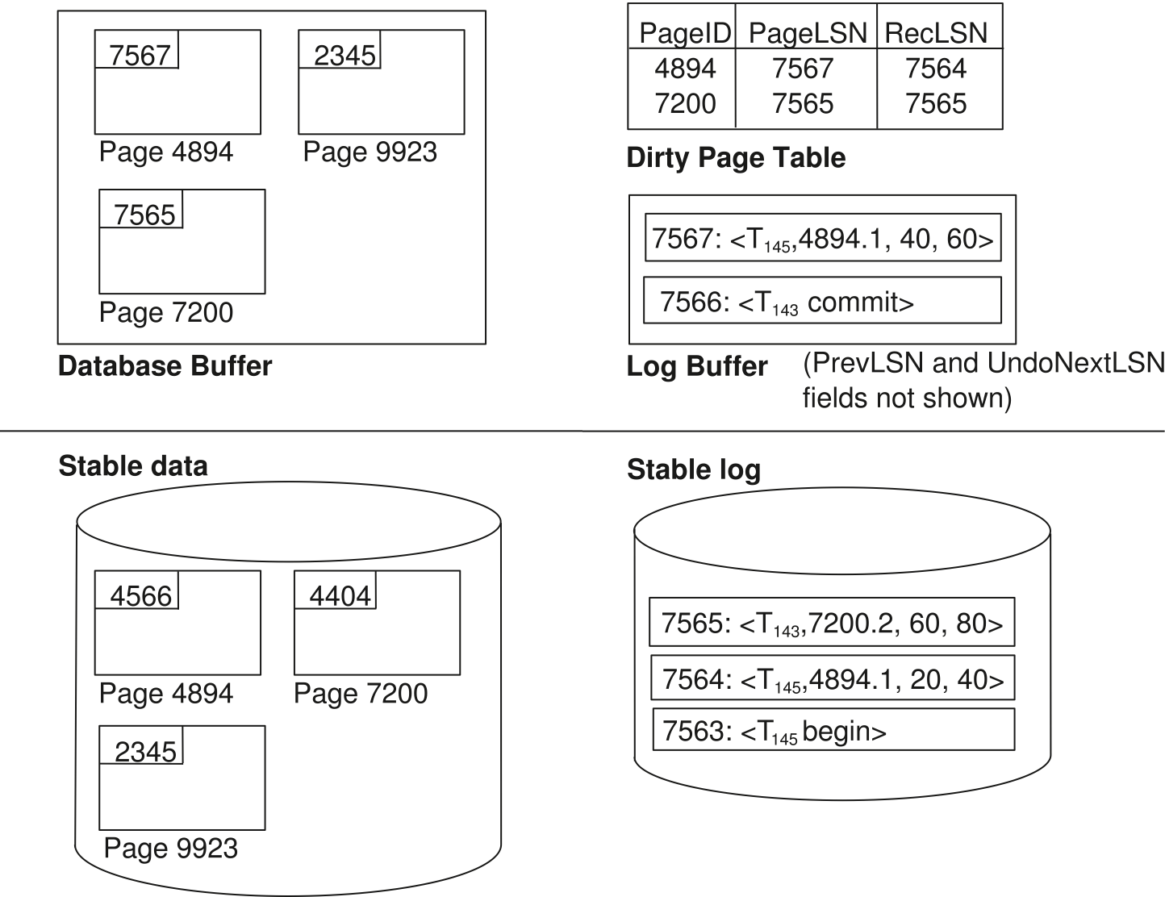
ARIES Data Structures

Slide 59
ARIES Data Structures: Checkpoint Log
Checkpoint log record
Contains:
DirtyPageTable and list of active transactions
For each active transaction, LastLSN, the LSN of the last log record written by the transaction
Fixed position on disk notes LSN of last completed checkpoint log record
Dirty pages are not written out at checkpoint time
Instead, they are flushed out continuously, in the background
Checkpoint is thus very low overhead
can be done frequently

Slide 60
ARIES Recovery Algorithm
ARIES recovery involves three passes
Analysis pass: Determines
Which transactions to undo
Which pages were dirty (disk version not up to date) at time of crash
RedoLSN: LSN from which redo should start
Redo pass:
Repeats history, redoing all actions from RedoLSN
RecLSN and PageLSNs are used to avoid redoing actions already reflected on page
Undo pass:
Rolls back all incomplete transactions
Transactions whose abort was complete earlier are not undone
Key idea: no need to undo these transactions: earlier undo actions were logged, and are redone as required

Slide 61
Aries Recovery: 3 Passes
Analysis, redo and undo passes
Analysis determines where redo should start
Undo has to go back till start of earliest incomplete transaction
Last checkpoint
End of Log
Time
Log
Analysis pass
Redo pass
Undo pass

Slide 62
ARIES Recovery: Analysis
Analysis pass
Starts from last complete checkpoint log record
Reads DirtyPageTable from log record
Sets RedoLSN = min of RecLSNs of all pages in DirtyPageTable
In case no pages are dirty, RedoLSN = checkpoint record’s LSN
Sets undo-list = list of transactions in checkpoint log record
Reads LSN of last log record for each transaction in undo-list from checkpoint log record
Scans forward from checkpoint
.. Cont. on next page …

Slide 63
ARIES Recovery: Analysis (Cont.)
Analysis pass (cont.)
Scans forward from checkpoint
If any log record found for transaction not in undo-list, adds transaction to undo-list
Whenever an update log record is found
If page is not in DirtyPageTable, it is added with RecLSN set to LSN of the update log record
If transaction end log record found, delete transaction from undo-list
Keeps track of last log record for each transaction in undo-list
May be needed for later undo
At end of analysis pass:
RedoLSN determines where to start redo pass
RecLSN for each page in DirtyPageTable used to minimize redo work
All transactions in undo-list need to be rolled back

Slide 64
ARIES Redo Pass
Redo Pass: Repeats history by replaying every action not already reflected in the page on disk, as follows:
Scans forward from RedoLSN. Whenever an update log record is found:
If the page is not in DirtyPageTable or the LSN of the log record is less than the RecLSN of the page in DirtyPageTable, then skip the log record
Otherwise fetch the page from disk. If the PageLSN of the page fetched from disk is less than the LSN of the log record, redo the log record
NOTE: if either test is negative the effects of the log record have already appeared on the page. First test avoids even fetching the page from disk!

Slide 65
ARIES Undo Actions
When an undo is performed for an update log record
Generate a CLR containing the undo action performed (actions performed during undo are logged physicaly or physiologically).
CLR for record n noted as n’ in figure below
Set UndoNextLSN of the CLR to the PrevLSN value of the update log record
Arrows indicate UndoNextLSN value
ARIES supports partial rollback
Used e.g. to handle deadlocks by rolling back just enough to release reqd. locks
Figure indicates forward actions after partial rollbacks
records 3 and 4 initially, later 5 and 6, then full rollback
1
2
3
4
4'
3'
5
6
6'
5'
1'
2'

Slide 66
ARIES: Undo Pass
Undo pass:
Performs backward scan on log undoing all transaction in undo-list
Backward scan optimized by skipping unneeded log records as follows:
Next LSN to be undone for each transaction set to LSN of last log record for transaction found by analysis pass.
At each step pick largest of these LSNs to undo, skip back to it and undo it
After undoing a log record
For ordinary log records, set next LSN to be undone for transaction to PrevLSN noted in the log record
For compensation log records (CLRs) set next LSN to be undo to UndoNextLSN noted in the log record
All intervening records are skipped since they would have been undone already
Undos performed as described earlier

Slide 67
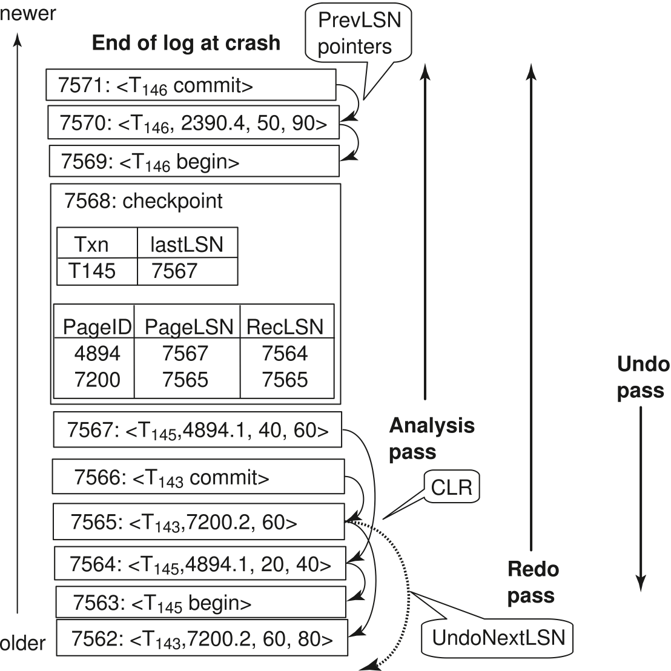
Recovery Actions in ARIES

Slide 68
Other ARIES Features
Recovery Independence
Pages can be recovered independently of others
E.g. if some disk pages fail they can be recovered from a backup while other pages are being used
Savepoints:
Transactions can record savepoints and roll back to a savepoint
Useful for complex transactions
Also used to rollback just enough to release locks on deadlock

Slide 69
Other ARIES Features (Cont.)
Fine-grained locking:
Index concurrency algorithms that permit tuple level locking on indices can be used
These require logical undo, rather than physical undo, as in earlier recovery algorithm
Recovery optimizations: For example:
Dirty page table can be used to prefetch pages during redo
Out of order redo is possible:
redo can be postponed on a page being fetched from disk, and performed when page is fetched.
Meanwhile other log records can continue to be processed

Slide 70
Remote Backup Systems

Slide 71
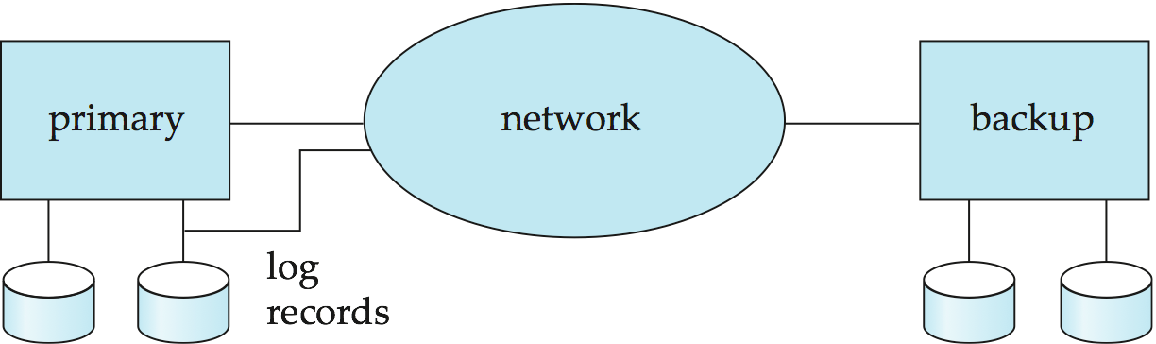
Remote Backup Systems
Remote backup systems provide high availability by allowing transaction processing to continue even if the primary site is destroyed.

Slide 72
Remote Backup Systems (Cont.)
Detection of failure: Backup site must detect when primary site has failed
to distinguish primary site failure from link failure maintain several communication links between the primary and the remote backup.
Heart-beat messages
Transfer of control:
To take over control backup site first perform recovery using its copy of the database and all the long records it has received from the primary.
Thus, completed transactions are redone and incomplete transactions are rolled back.
When the backup site takes over processing it becomes the new primary
To transfer control back to old primary when it recovers, old primary must receive redo logs from the old backup and apply all updates locally.

Slide 73
Remote Backup Systems (Cont.)
Time to recover: To reduce delay in takeover, backup site periodically proceses the redo log records (in effect, performing recovery from previous database state), performs a checkpoint, and can then delete earlier parts of the log.
Hot-Spare configuration permits very fast takeover:
Backup continually processes redo log record as they arrive, applying the updates locally.
When failure of the primary is detected the backup rolls back incomplete transactions, and is ready to process new transactions.
Alternative to remote backup: distributed database with replicated data
Remote backup is faster and cheaper, but less tolerant to failure
more on this in Chapter 19

Slide 74
Remote Backup Systems (Cont.)
Ensure durability of updates by delaying transaction commit until update is logged at backup; avoid this delay by permitting lower degrees of durability.
One-safe: commit as soon as transaction’s commit log record is written at primary
Problem: updates may not arrive at backup before it takes over.
Two-very-safe: commit when transaction’s commit log record is written at primary and backup
Reduces availability since transactions cannot commit if either site fails.
Two-safe: proceed as in two-very-safe if both primary and backup are active. If only the primary is active, the transaction commits as soon as is commit log record is written at the primary.
Better availability than two-very-safe; avoids problem of lost transactions in one-safe.

Slide 75
End of Chapter 16

Slide 76
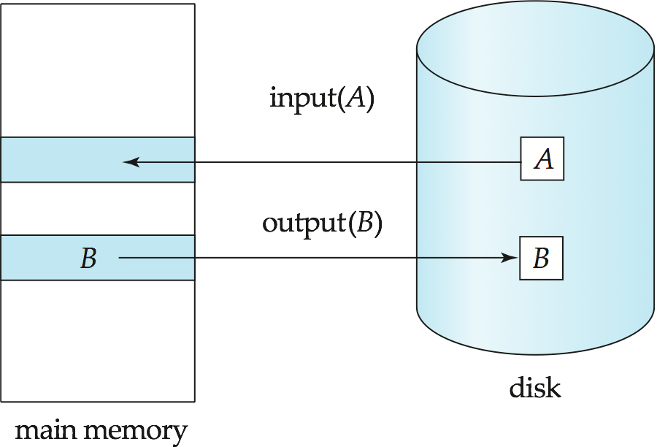
Figure 16.01

Slide 77
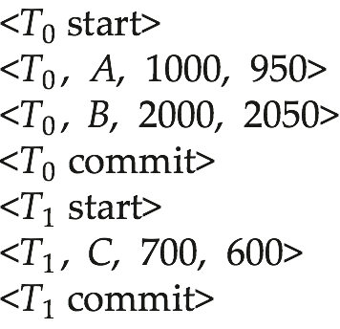
Figure 16.02

Slide 78
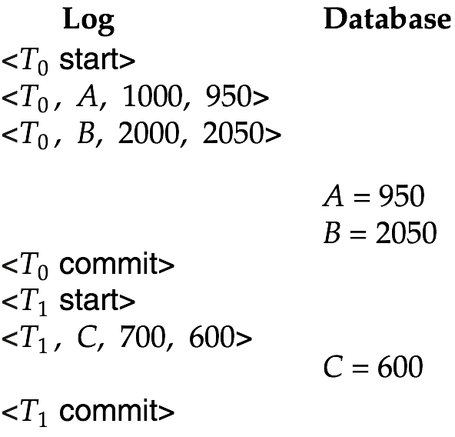
Figure 16.03

Slide 79
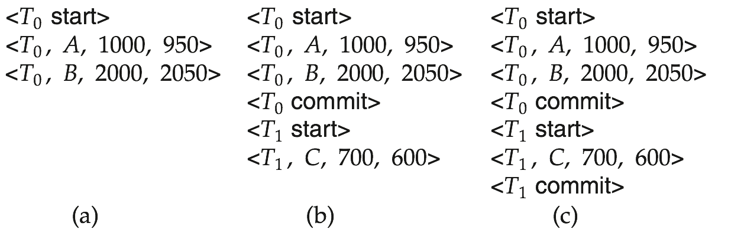
Figure 16.04

Slide 80
Figure 16.05

Slide 81
Figure 16.06

Slide 82
Figure 16.08

Slide 83
Figure 16.09

Slide 84

Figure 16.10

Slide 85
Extra

Slide 86
Shadow Paging
Shadow paging is an alternative to log-based recovery; this scheme is useful if transactions execute serially
Idea: maintain two page tables during the lifetime of a transaction –the current page table, and the shadow page table
Store the shadow page table in nonvolatile storage, such that state of the database prior to transaction execution may be recovered.
Shadow page table is never modified during execution
To start with, both the page tables are identical. Only current page table is used for data item accesses during execution of the transaction.
Whenever any page is about to be written for the first time
A copy of this page is made onto an unused page.
The current page table is then made to point to the copy
The update is performed on the copy

Slide 87
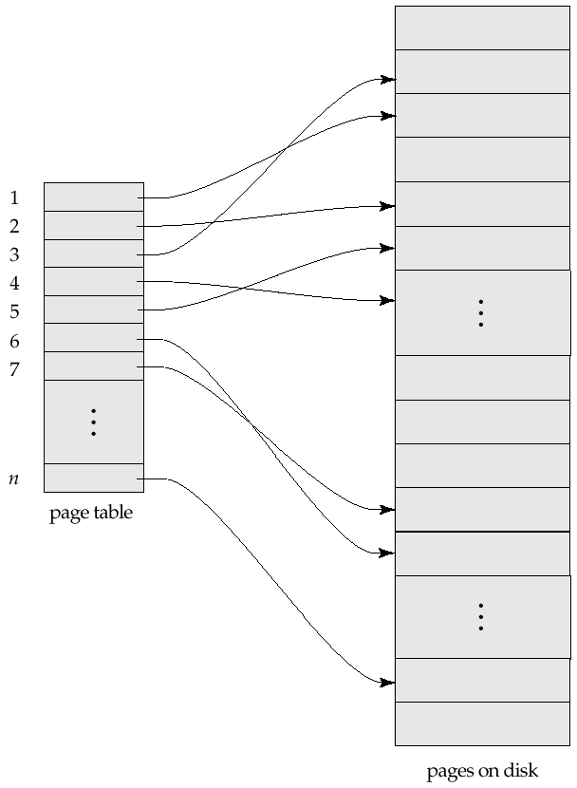
Sample Page Table

Slide 88
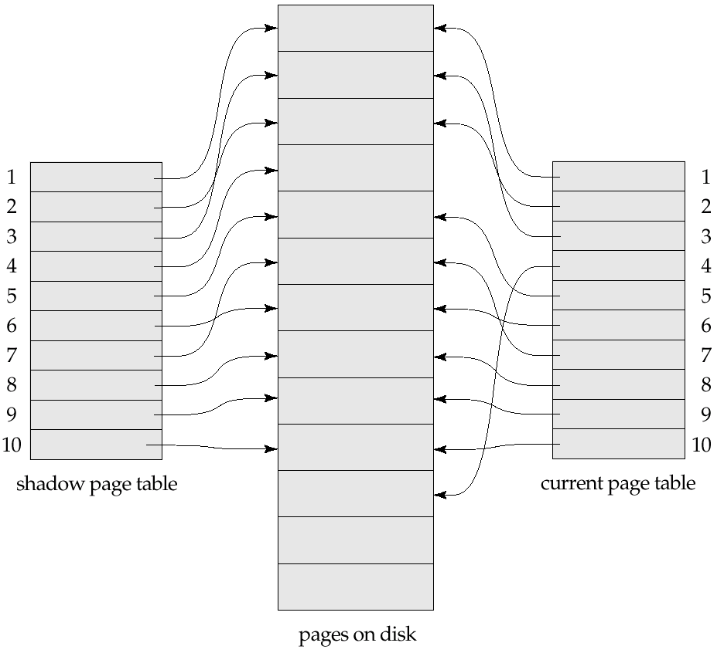
Example of Shadow Paging
Shadow and current page tables after write to page 4

Slide 89
Shadow Paging (Cont.)
To commit a transaction :
1. Flush all modified pages in main memory to disk
2. Output current page table to disk
3. Make the current page table the new shadow page table, as follows:
keep a pointer to the shadow page table at a fixed (known) location on disk.
to make the current page table the new shadow page table, simply update the pointer to point to current page table on disk
Once pointer to shadow page table has been written, transaction is committed.
No recovery is needed after a crash — new transactions can start right away, using the shadow page table.
Pages not pointed to from current/shadow page table should be freed (garbage collected).

Slide 90
Show Paging (Cont.)
Advantages of shadow-paging over log-based schemes
no overhead of writing log records
recovery is trivial
Disadvantages :
Copying the entire page table is very expensive
Can be reduced by using a page table structured like a B⁺-tree
No need to copy entire tree, only need to copy paths in the tree that lead to updated leaf nodes
Commit overhead is high even with above extension
Need to flush every updated page, and page table
Data gets fragmented (related pages get separated on disk)
After every transaction completion, the database pages containing old versions of modified data need to be garbage collected
Hard to extend algorithm to allow transactions to run concurrently
Easier to extend log based schemes

Slide 91

Block Storage Operations

Slide 92
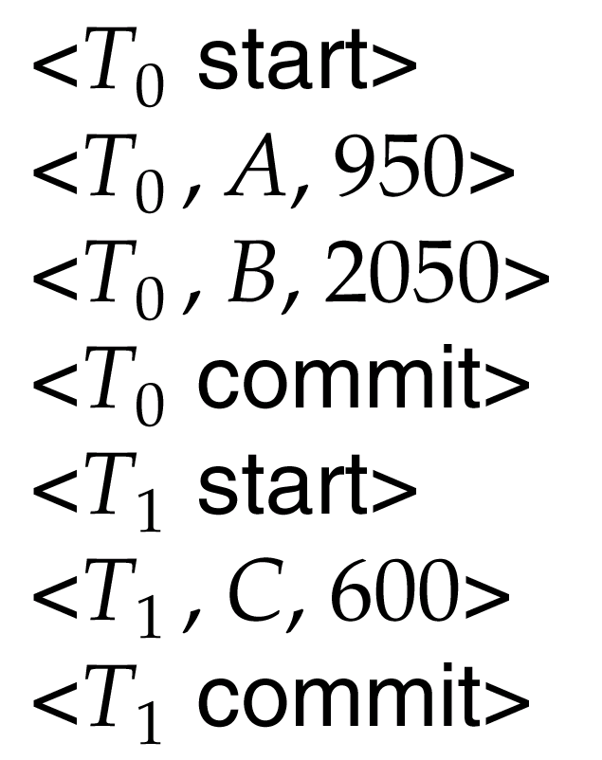
Portion of the Database Log Corresponding to T₀ and T₁

Slide 93
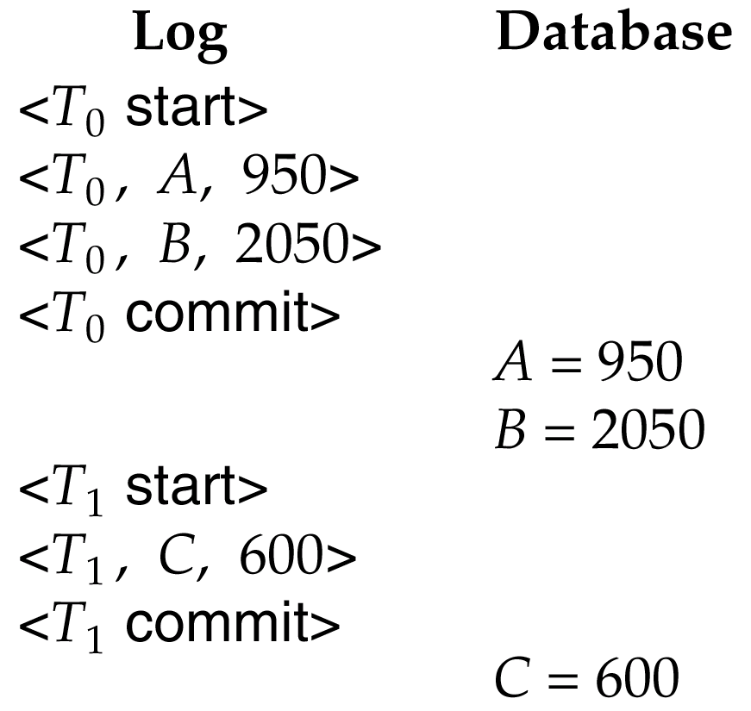
State of the Log and Database Corresponding to T₀ and T₁

Slide 94
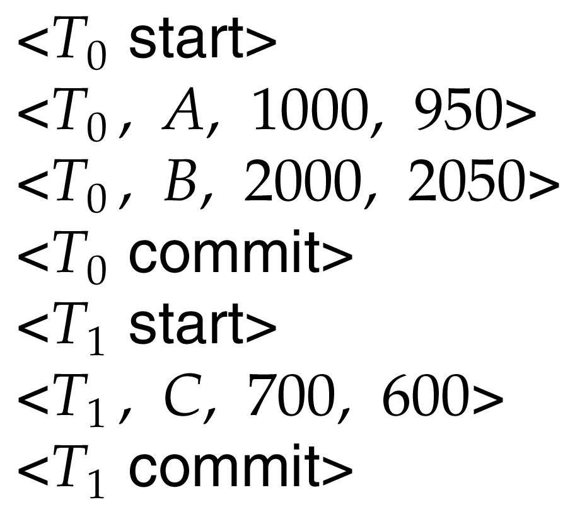
Portion of the System Log Corresponding to T₀ and T₁

Slide 95
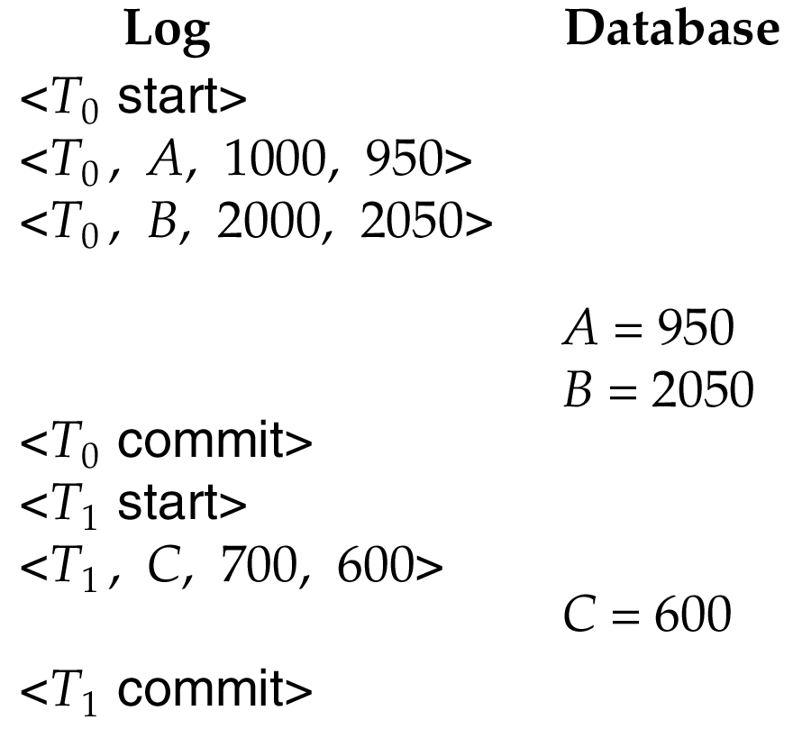
State of System Log and Database Corresponding to T₀ and T₁

